Slide 1
SQL Data Analysis and Visualization with Power BI for FDA
By – Nitisha Tyagi

Slide 2

Business Understanding
The FDA's mission is to protect and promote public health by ensuring the safety and effectiveness of a wide range of products and substances. By studying data the purpose is to generate meaningful insights.

Slide 3
Data Understanding
The available data provides the number of application approved over the period of years, the products that are approved, their marketing status , therapeutic codes and the dosage form .

Slide 4

Data Preparation
Challenges faced during Preparation
Dealing with the null values.
Writing the sql queries.
Splitting the dosage column in order to find the form

Slide 5
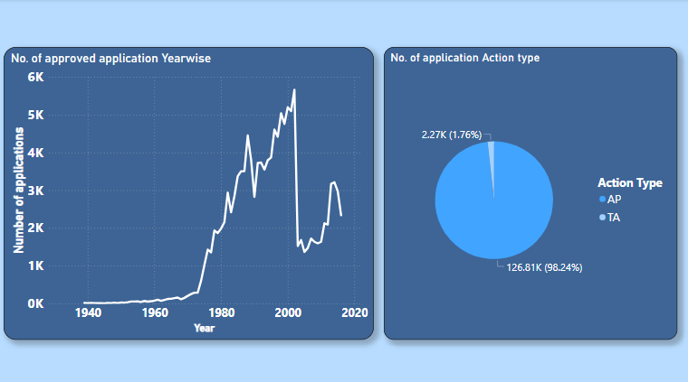
Visualize the yearly approval trends of drugs. Highlight any significant patterns and/or fluctuations

Slide 6
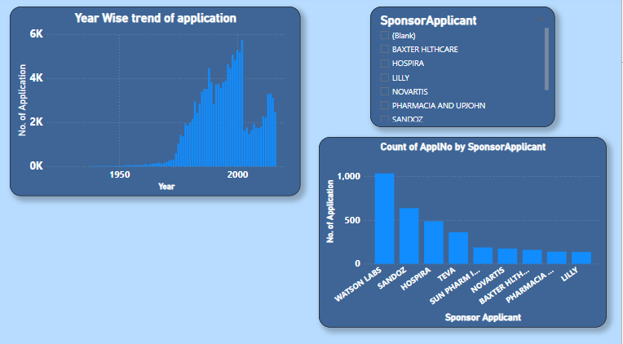
Explore approval trends over the years based on different sponsors. Uncover patterns and changes in approval rates among sponsors.

Slide 7
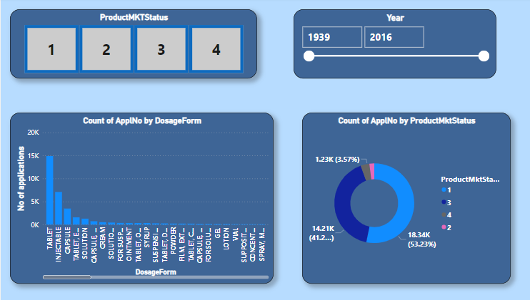
Visualize the segmentation of products based on Marketing Status.

Slide 8
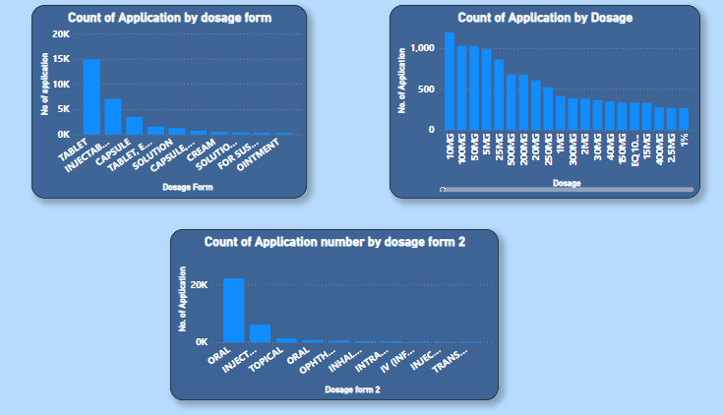
Show the total number of applications for each Marketing Status. Enable users to filter by years and Marketing Status for detailed analysis

Slide 9
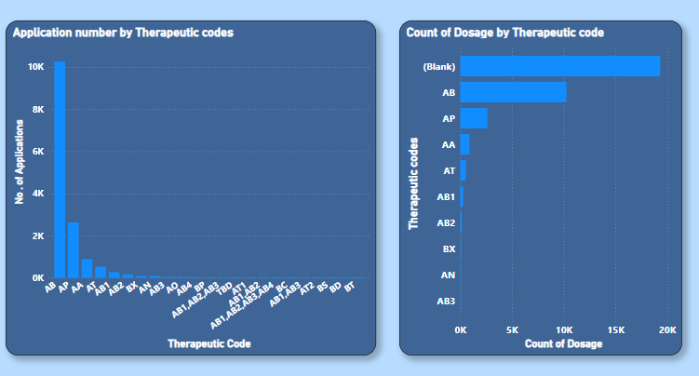
Visualize drug approvals based on therapeutic classes. Identify classes with the highest number of approvals.

Slide 10
THANK YOU

